Slide 1

Electrical Networks

Slide 2
CONTENTS
FARADAY’S LAW OF ELECTROMAGNETIC INDUCTION
LENZ’S LAW
SELF-INDUCTANCE
INDUCED VOLTAGE
INDUCTORS IN SERIES AND PARALLEL
MUTUAL INDUCTANCE
DOT CONVENTION
ENERGY IN A COUPLED CIRCUIT
COUPLING COEFFICIENT

Slide 3
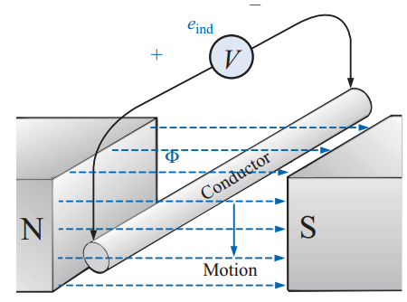
FARADAY’S LAW OF ELECTROMAGNETIC INDUCTION
If a conductor is moved through a magnetic field so that it cuts magnetic lines of flux, a voltage will be induced across the conductor.
The greater the number of flux lines cut per unit time (or) the stronger the magnetic field strength, the greater will be the induced voltage across the conductor.
If the conductor is held fixed and the magnetic field is moved so that its flux lines cut the conductor, the same effect will be produced.

Slide 4
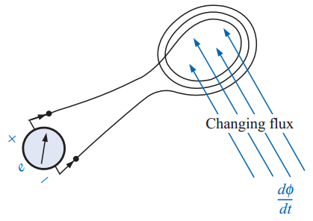

FARADAY’S LAW OF ELECTROMAGNETIC INDUCTION
Fig: Demonstrating Faraday’s law
If a coil of N turns is placed in the region of a changing flux, a voltage will be induced across the coil as determined by
If the flux linking the coil ceases to change, such as when the coil simply sits still in a magnetic field of fixed strength, (dϕ/dt)=0, and the induced voltage e= 0 volts.

Slide 5
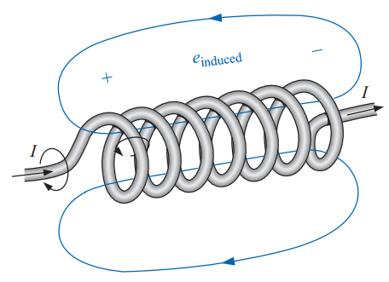
LENZ’S LAW
Definition: An induced effect is always such as to oppose the cause that produced it.
Fig: Demonstrating the effect of Lenz’s law
The polarity of this induced voltage tends to establish a current in the coil that produces a flux that will oppose any change in the original flux.

Slide 6
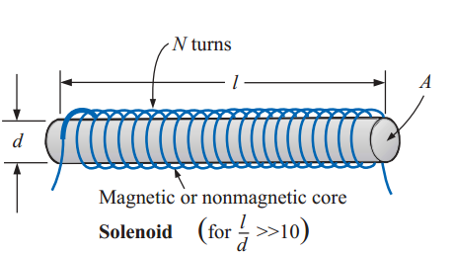

SELF-INDUCTANCE
The ability of a coil to oppose any change in current is a measure of the self-inductance L of the coil.
For brevity, the prefix self is usually dropped. Inductance is measured in henries (H)
The inductance of a coil varies directly with the magnetic properties of the coil.
N-the number of turns
µ-permeability of the core
A-area of the core
l- mean length of the core

Slide 7


SELF-INDUCTANCE
Substituting µ=µ_{r}µ_{o}
where L_{o} is the inductance of the coil with an air core.

Slide 8
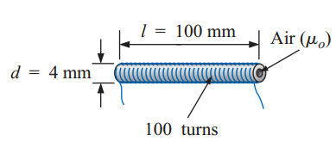
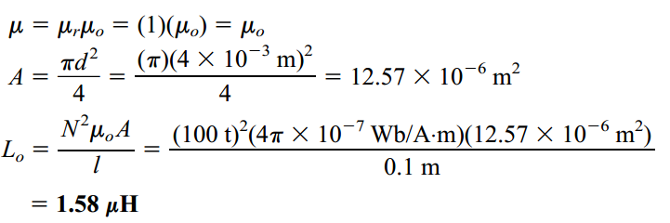
SELF-INDUCTANCE
EXAMPLE.1
Find the inductance of the air-core coil of Fig.
Solution:
EXAMPLE.2
Repeat Example.1, but with an iron core and conditions such that µ_{r}=2000.

Slide 9
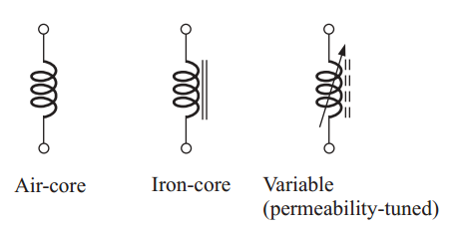
SYMBOLS
All inductors, like capacitors, can be listed under two general headings: fixed and variable.
The permeability-tuned variable coil has a ferromagnetic shaft that can be moved within the coil to vary the flux linkages of the coil and thereby its inductance.

Slide 10


INDUCED VOLTAGE
The inductance of a coil is also a measure of the change in flux linking a coil due to a change in current through the coil; that is,
where N is the number of turns,ϕ is the flux in webers, and i is the current through the coil.
The above Equation also reveals that the larger the inductance of a coil (with N fixed), the larger will be the instantaneous change in flux linking the coil due to an instantaneous change in current through the coil.

Slide 11


INDUCED VOLTAGE
The magnitude of the voltage across an inductor is directly related to the inductance L and the instantaneous rate of change of current through the coil.
If the current through the coil fails to change at a particular instant, the induced voltage across the coil will be zero.
For dc applications, after the transient effect has passed, di/dt =0 , and the induced voltage is

Slide 12

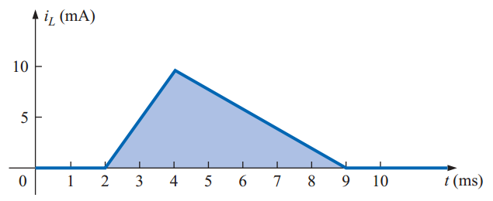
INDUCED VOLTAGE
The average voltage across the coil is defined by the equation
EXAMPLE.3
Find the waveform for the average voltage across the coil if the current through a 4-mH coil is as shown in Fig.

Slide 13
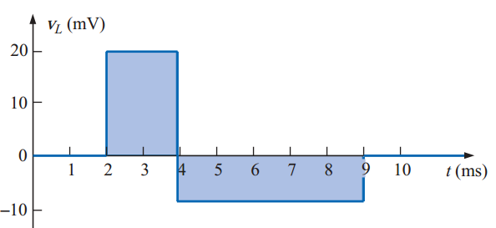
INDUCED VOLTAGE
Solution:
0 to 2 ms: V_{L}=0
2 ms to 4 ms: V_{L}=20 mV
4 ms to 9 ms:V_{L}= - 8 mV
9 ms to ∞:V_{L}=0
The waveform for the average voltage across the coil is shown in Fig.
The voltage across the coil is not determined solely by the magnitude of the change in current through the coil (di), but also by the rate of change of current through the coil (di/dt).

Slide 14
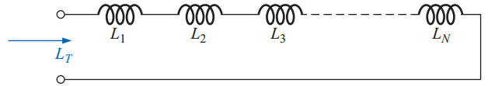

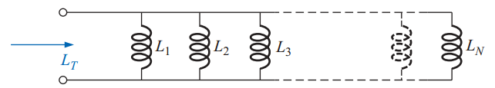


INDUCTORS IN SERIES AND PARALLEL
For inductors in series, the total inductance is found in the same manner as the total resistance of resistors in series.
For inductors in parallel, the total inductance is found in the same manner as the total resistance of resistors in parallel.
For two inductors in parallel,

Slide 15
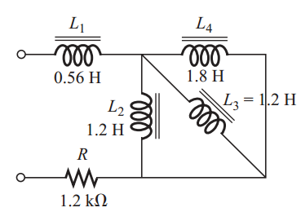
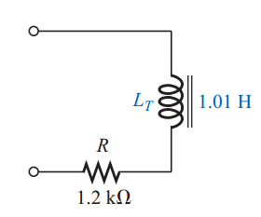
EXAMPLE.3
Reduce the network of Fig. to its simplest form.
SOLUTION:
The reduced equivalent network

Slide 16
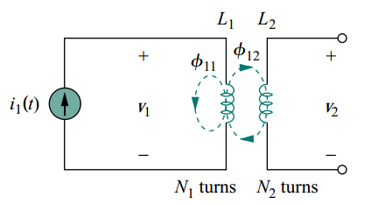

MUTUAL INDUCTANCE
Mutual inductance is the ability of one inductor to induced voltage across a neighboring inductor, measured in henrys (H).
Now consider two coils with self-inductances L₁ and L₂ that are in close proximity with each other.
For the sake of simplicity, assume that the second inductor carries no current.
The magnetic flux φ1 emanating from coil 1 has two components:

Slide 17





MUTUAL INDUCTANCE
Although the two coils are physically separated, they are said to be magnetically coupled.
Since the entire flux φ₁ links coil 1, the voltage induced in coil 1 is
Only flux φ₁₂ links coil 2, so the voltage induced in coil 2 is
Again, as the fluxes are caused by current i₁ flowing in coil 1
Similarly,
Where

Slide 18

MUTUAL INDUCTANCE
M₂₁ is known as the mutual inductance of coil 2 with respect to coil 1.
Subscript 21 indicates that the inductance M₂₁ relates the voltage induced in coil 2 to the current in coil 1.
we refer to M as the mutual inductance between the two coils
Keep in mind that mutual coupling only exists when the inductors or coils are in close proximity, and the circuits are driven by time-varying sources.

Slide 19
DOT CONVENTION
Although mutual inductance M is always a positive quantity, the mutual voltage M di/dt may be negative or positive, just like the self induced voltage L di/dt.
The polarity of mutual voltage M di/dt is not easy to determine, because four terminals are involved.
It is made by examining the orientation or particular way in which both coils are physically wound and applying Lenz’s law in conjunction with the right-hand rule.
Since it is inconvenient to show the construction details of coils on a circuit schematic, we apply the dot convention in circuit analysis.

Slide 20
DOT CONVENTION
If a current enters the dotted terminal of one coil, the reference polarity of the mutual voltage in the second coil is positive at the dotted terminal of the second coil.
OR
If a current leaves the dotted terminal of one coil, the reference polarity of the mutual voltage in the second coil is negative at the dotted terminal of the second coil.
Thus, the reference polarity of the mutual voltage depends on the reference direction of the inducing current and the dots on the coupled coils.

Slide 21
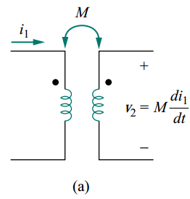
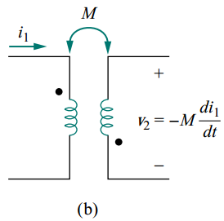
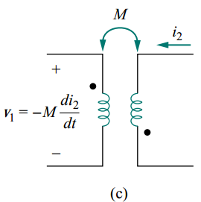
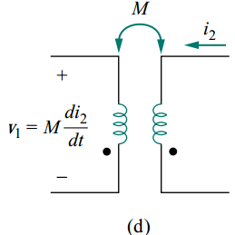
DOT CONVENTION
Application of the dot convention is illustrated in the four pairs of mutually coupled coils as follows.
 | In Fig a | In Fig b | In Fig c | In Fig d
At dotted terminal of the coil 1 | i₁ enters | i₁ enters | v₁ is positive | v₁ is negative
At dotted terminal of the coil 2 | v₂ is positive | v₂ is negative | i₂ leaves | i₂ leaves
The mutual voltage | +Mdi₁/dt | −M di₁/dt. | −M di₂/dt. | +Mdi₂/dt

Slide 22
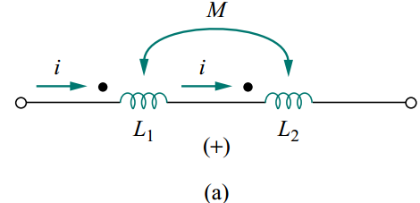

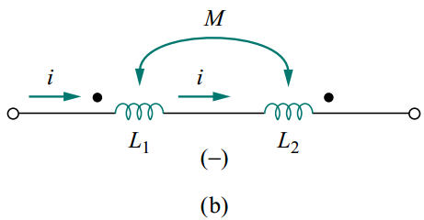

DOT CONVENTION
The dot convention for coupled coils in series.
the total inductance is
Fig: the sign indicates the polarity of the mutual voltage: (a) series-aiding connection, (b) series-opposing connection.

Slide 23
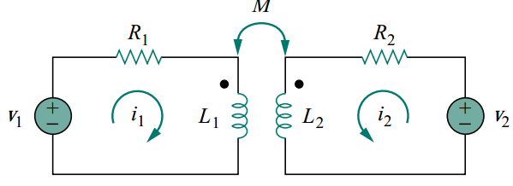
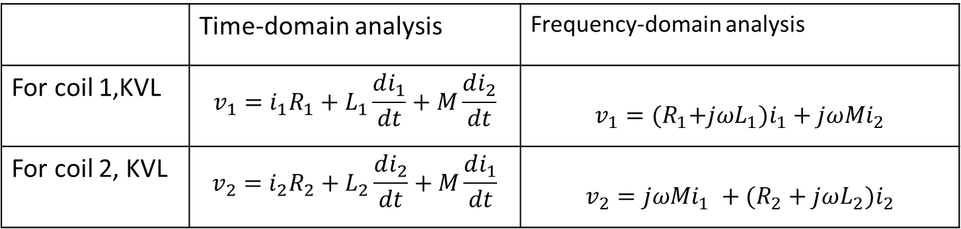
DOT CONVENTION
EXAMPLE:(a)
Fig: Time-domain analysis of a circuit containing coupled coils.
 | Time-domain analysis | Frequency-domain analysis
For coil 1,KVL | $$v_{1}=i_{1}R_{1}+L_{1}\frac{di_{1}}{dt}+M\frac{di_{2}}{dt}$$ | $$v_{1}={(R}_{1}+jωL_{1})i_{1}+jωMi_{2}$$
For coil 2, KVL | $$v_{2}=i_{2}R_{2}+L_{2}\frac{di_{2}}{dt}+M\frac{di_{1}}{dt}$$ | $$v_{2}={jωMi_{1} +(R}_{2}+jωL_{2})i_{2}$$

Slide 24
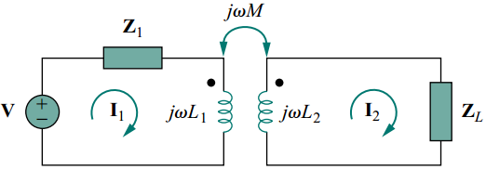
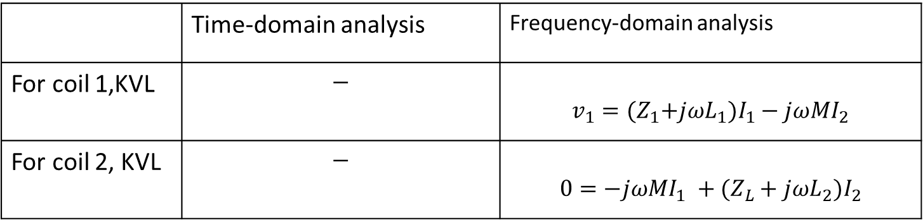
DOT CONVENTION
EXAMPLE (b)
Fig: Frequency-domain analysis of a circuit containing coupled coils
 | Time-domain analysis | Frequency-domain analysis
For coil 1,KVL | $$−$$ | $$v_{1}={(Z}_{1}+jωL_{1})I_{1}−jωMI_{2}$$
For coil 2, KVL | $$−$$ | $$0=−{jωMI_{1} +(Z}_{L}+jωL_{2})I_{2}$$

Slide 25
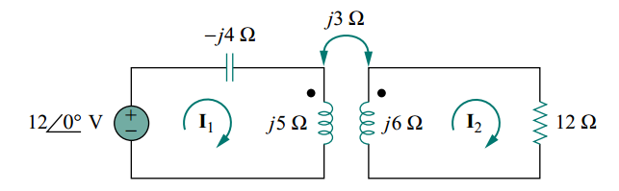






PROBLEM:
Calculate the phasor currents I₁ and I₂ in the circuit of Fig.
Fig.
SOLUTION
By using Substitution method,
For coil 1
For coil 2

Slide 26
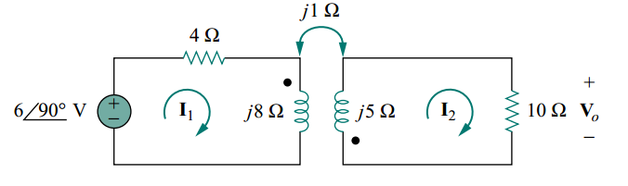
PRACTICE PROBLEM.1:
Determine the voltage Vo in the circuit of Fig
Fig

Slide 27
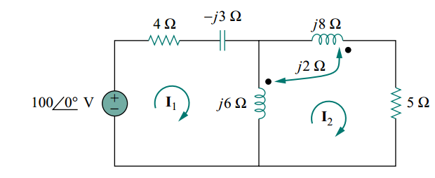
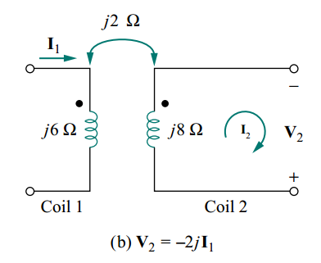
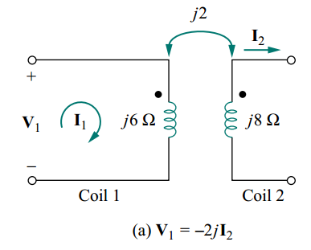
PRACTICE PROBLEM.2:
Calculate the mesh currents in the circuit of following fig.
Clue to solve this problem

Slide 28
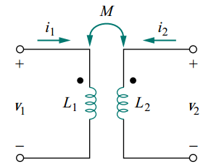


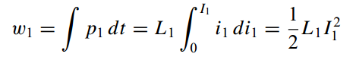
ENERGY IN A COUPLED CIRCUIT
The energy stored in an inductor is given by
We assume that currents i₁ and i₂ are zero initially, so that the energy stored in the coils is zero.
CASE 1:
Fig: The circuit for deriving energy stored in a coupled circuit
If we let i₁ increase from zero to I₁ while maintaining i₂ = 0, the power in coil 1 is
The energy stored in the circuit is

Slide 29

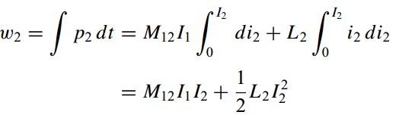

ENERGY IN A COUPLED CIRCUIT
CASE 2:
If we now maintain i₁ = I₁ and increase i₂ from zero to I₂, The mutual voltage induced in coil 1 is M₁₂ =di₂/dt, while the mutual voltage induced in coil 2 is zero, since i₁ does not change(M di/dt =0).
The power in the coils is now
The energy stored in the circuit is
The total energy stored in the coils when both i₁ and i₂ have reached constant values is

Slide 30



ENERGY IN A COUPLED CIRCUIT
If we reverse the order by which the currents reach their final values, then M₁₂ become M_{21,} the total energy stored in the coils is
The total energy stored should be the same regardless of how we reach the final conditions. Therefore
This equation was derived based on the assumption that the coil currents both entered the dotted terminals.

Slide 31


ENERGY IN A COUPLED CIRCUIT
If one current enters one dotted terminal while the other current leaves the other dotted terminal, the mutual voltage is negative, so that the mutual energy MI₁I₂ is also negative.
In that case,
The general expression for the instantaneous energy stored in the circuit is

Slide 32



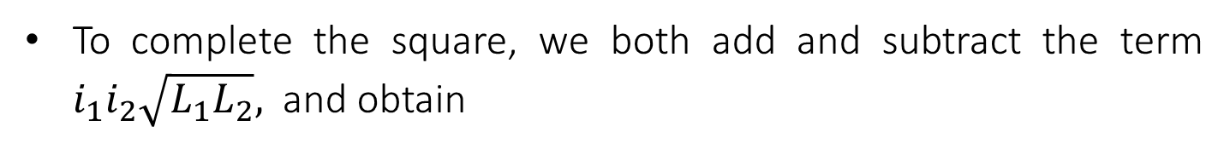
UPPER LIMIT FOR THE MUTUAL INDUCTANCE M
The energy stored in the circuit cannot be negative because the circuit is passive.
This means that the quantity
To complete the square, we both add and subtract the term $i_{1}i_{2}\sqrt{L_{1}L_{2}},$ and obtain
The squared term is never negative; Therefore, the second term on the right-hand side of above Eq. must be greater than zero; that is,
Thus, the mutual inductance cannot be greater than the geometric mean of the self-inductances of the coils.

Slide 33
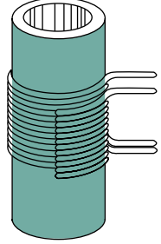


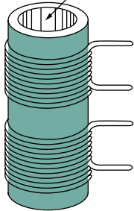


COUPLING COEFFICIENT
The degree to which M approaches its maximum value is described by the coupling coefficient.
OR
If k>0.5 then we can say the coils which are physically closer as shown in Fig(a) and if k<0.5 then the coils are loosely coupled as shown in Fig(b).
(a)Tightly coupled
If the entire flux produced by one coil links another coil, then k = 1(100 percent coupling or perfectly coupled)
So, the coupling coefficient is the fraction of the total flux emanating from one coil that links the other coil.
OR
(b) Loosely coupled

Slide 34
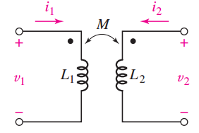


PROBLEM:
In Fig., let L₁ = 0.4 H, L₂ = 2.5 H, k = 0.6, and i₁ = 4i₂ = 20 cos (500t − 20◦) mA. Determine both v₁(0) and the total energy stored in the system at t = 0.
SOLUTION
To determine the value of v₁, apply KVL and also paying attention to the dot convention
To evaluate this quantity, we require a value for M

Slide 35



The total energy is found by summing the energy stored in each inductor, which has three separate components since the two coils are known to be magnetically coupled. Since both currents enter a “dotted’’ terminal,
Current through coil 1 at t = 0
Current through coil 2 at t = 0
The total energy stored in the two coils at t = 0, is 151.2 µJ

Slide 36
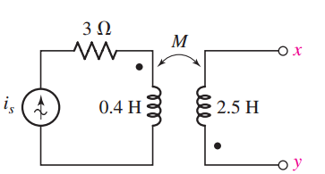

PRACTICE PROBLEM1:
Let I_{s} = 2cos(10t) A in the circuit of Fig., and find the total energy stored in the passive network at t = 0 if k = 0.6 and terminals x and y are (a) left open-circuited; (b) short-circuited.

Slide 37
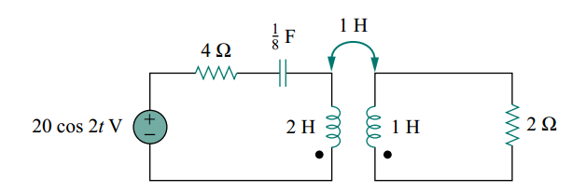

PRACTICE PROBLEM2:
For the circuit in Fig., determine the coupling coefficient and the energy stored in the coupled inductors at t = 1.5 s.

